Slide 1
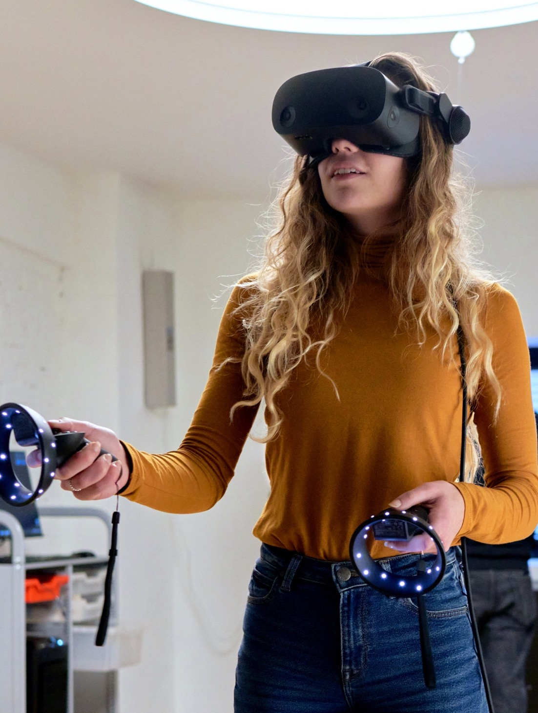
Immersive Learning
Braiding the Digital and Physical to Support Student Success
Notes:
Welcome to our presentation on immersive learning experiences, where we will discuss the integration of digital and physical spaces to support the success of students.

Slide 2
Digital Transformation of Learning
Technology can connect and disconnect learners Technology—including immersive technologies—can both connect learners over distance and time and be a barrier to their education.
Learners are both creators and viewers Technology can allow learners to be active agents in creating their own content.
Collaboration is both human-to-human and human-to-computer​ Learning environments need to support both human-to-human collaboration and human-to-computer collaboration.
Through our exploration into the digital transformation of learning, we have studied blended learning, hybrid learning, e-sports, and more.
Notes:
As we continue to explore digital transformation’s impact on learning, we have studied the impact of digital learning on blended and hybrid learning, e-sports, and more. And what we’ve learned is that:
Technology can connect and disconnect learners Learners are both creators and viewers
Collaboration is both human-to-human and human-to-computer
Artificial Intelligence (AI) brings new opportunities and challenges

Slide 3
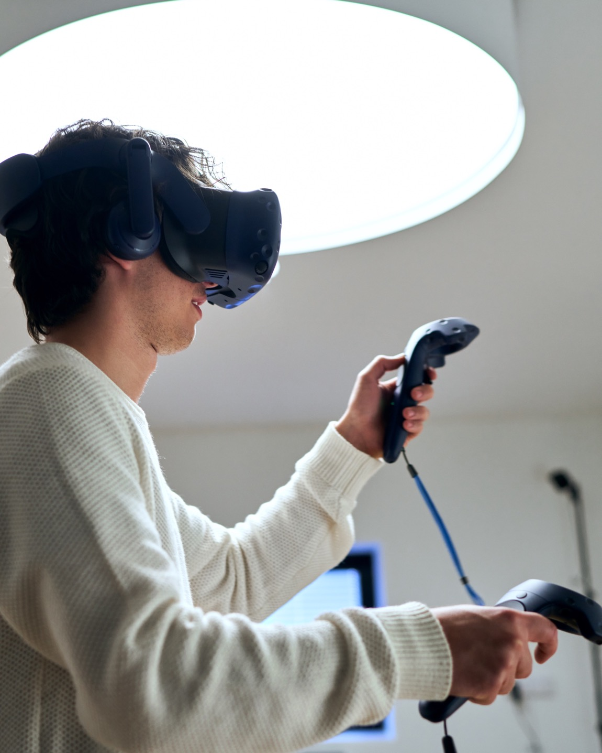
Learning environments need to be reimagined to support immersive learning experiences.
Notes:
To effectively implement immersive learning, learning environments need to be reimagined to support the experience.

Slide 4
Introduction to immersive learning
Notes:
As we dig into how we can accommodate and integrate immersive learning in our classrooms, we plan to focus on three things:
1. Understanding how immersive technologies are applied in education​
​
2. Understanding the unique value of immersive technologies in student engagement in both K-12 and higher ed institutions​
​ 3. Identifying the design principles for creating effective immersive learning spaces

Slide 5
Our research User-centered and Data-driven
Research Methods
Literature review​
Educator interviews​
Student interviews​
School visits/engagements ​
Stimuli feedback ​
​Platform exploration
Notes:
Steelcase Learning researchers used multiple methods to understand immersive learning’s value to educational outcomes and how space can play a role to ensure an enhanced experience.
After reviewing published literature, we conducted primary research, including interviewing educators, students, and technologists and visited different campuses. We also tested different virtual reality and augmented reality platforms. Through synthesizing of the data collected, we identified pain points, insights, and design considerations.

Slide 6
Defining Immersive
Within immersive learning there are emerging technologies that are being employed to create digital realities.
Augmented Reality (AR)
Virtual Reality (VR)
Extended Reality (XR)
A digital experience that overlays computer-generated content onto the real world.
A digital experience that simulates a completely computer-generated environment for the user.
An experience that blends physical and digital environments to simulate artificial elements in the real world.
Notes:
Immersive learning is the leveraging of emerging technologies to create digital realities that impact the learning experience. The three most common are:
Augmented Reality (AR)—A digital experience that overlays computer-generated content onto the real world.
Virtual Reality (VR)—A digital experience that simulates a completely computer-generated environment for the user.
Extended Reality (XR)—An experience that blends physical and digital environments to simulate artificial elements in the real world.

Slide 7
“VR helps with digital literacy and student engagement.”
Chris 5th/6th grade teacher
Notes:
So let’s talk about the importance of VR for students, and its ability to improve engagement.
Virtual reality technology in education brings about excitement but also high expectations of its capabilities.
VR on its own is merely a tool. It has to be carefully and effectively implemented to assist in the learning process and provide interactive experiences, not just a static viewing. The lack of training available to educators and the very limited VR educational interactive content that supports a school curriculum holds many educators back.
Immersive technology provides unique and rich experiences for learning .
Immersive technologies offer various capabilities that are able to provide promising support for educators and students. VR gamifies learning but especially creates a safe space for risky, expensive, or otherwise not accessible experiences in more engaging ways and helps build empathy (e.g. welding, nursing).
Source: http://classvr.com/downloads/ClassVR-Whitepaper-A-Guide-To-AR-VR-In-Education.pdf

Slide 8
We are already living a physical-digital braided experience.
Spatial Audio
Desktop Displays
Handheld Displays
Head Unit
Virtual Cave
Basic
Full
Notes:
We are already living a physical-digital braided experience.
One of the main goals of virtual reality is to provide immersive environments that take participants away from real life into a virtual one. There are different levels of immersive experiences, from spatial audio (like headphones) to desktop displays, handheld displays, and VR headsets to our Virtual Cave.
https://www.sciencedirect.com/science/article/pii/S1319157815000439

Slide 9
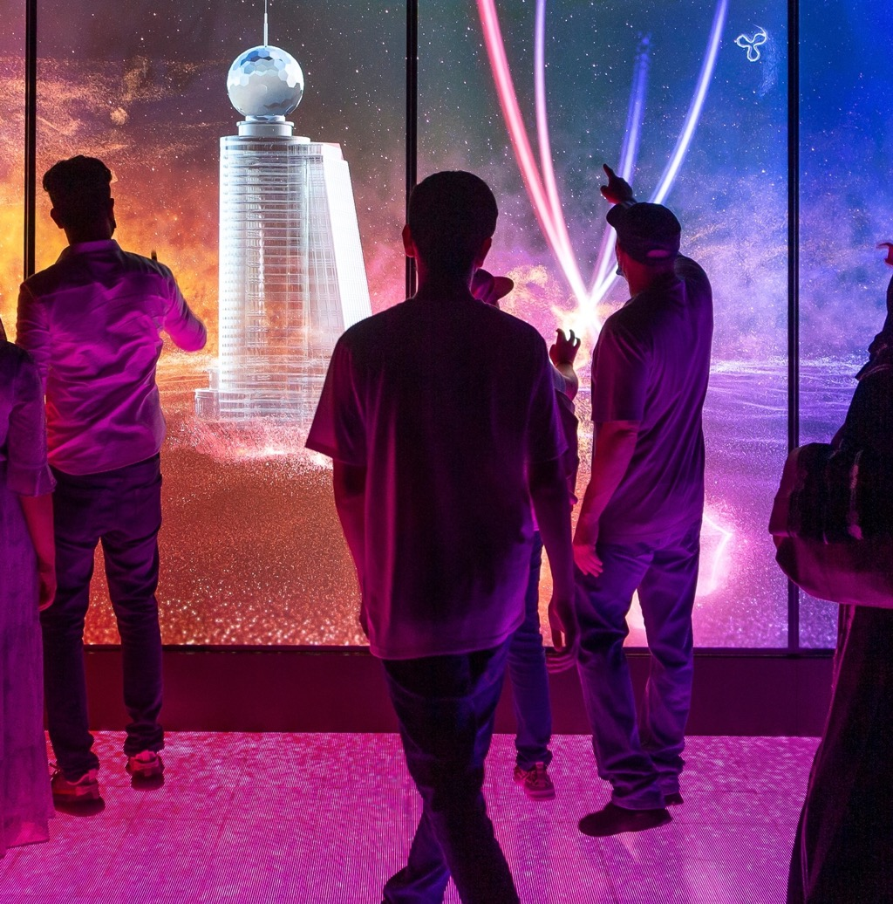
With each shift to a new era of computing, our environment adapted.
Central Computing
Computing at Desk
Computer with Me
Ubiquitous Computing
Rows & columns
Computer labs
Student work surfaces
VR zones & labs
Notes:
Every time we see a shift to a new era of computing, we also see a need for intentional design in spaces to adapt to more-immersive experiences.
This can look like moving from learning spaces that were rows and columns to more central computing.
Or more personal computing with school computer labs or multimedia podiums, as well as the need for large student work surfaces and more power hubs and outlets.
Mainframes and Mini Computers | Central computing
• Learning spaces were rows and columns
Personal Computing | Computing at my desk
• School computer labs
• Multimedia podiums
Mobile Computing | Bring the computer with me
• Large student work surfaces
• Power hubs/outlets
Immersive Experiences | Ubiquitous computing
• VR zones/labs
• Immersive caves

Slide 10
“VR training programs, on average, perform better than alternative training programs for developing social skills.” (Howard & Gutworth, 2019)
Immersive learning has encouraging effects on engagement and social skill development.
“Solid evidence has been already accumulated of the great advantage of HMDs for important non-cognitive learning factors such as engagement, motivation, and affection.”
(Makransky, Borre-Gude & Mayer 2019)
“While previous studies have shown mixed results, we found that HMDs have encouraging distinct effects on K-12 learners, improving both their knowledge and skill development. This is especially the case for science.” (Wu, Yu & Gu, 2020)
British Journal of Educational Technology Computers & Education Journal of Computer Assisted Learning
Notes:
And we are seeing that immersive learning has encouraging effects on engagement and social skill development.
Additional information:
Users Experience Motion Sickness “Despite advancements in VR technologies, many users still experience sickness symptoms” (Saredakis, Szpak, Birckhead, et al, 2020)
Sources:
https://news.mit.edu/2019/mit-jpal-what-126-studies-tell-us-about-education-technology-impact-0226
https://www.studyinternational.com/news/virtual-reality-technology-vr-learn-better/

Slide 11
Key Takeaways
01
02
03
Fluid and Dynamic Spaces
Postures and Movement​
Social Learning​
Provide flexible opportunities for digital experiences to support student learning
Create opportunities for a wide range of body movements and postures for higher engagement
Extending the immersive experience to secondary displays enables shared experiences
04
05
06
Inviting and Frictionless​
Physical Safety​
Active Storage
Inviting and well-designed spaces support and improve the experience
Materiality and objects in the immersive learning space should be considered for safety
Consider storage needs when determining which immersive experience devices to use
Notes:
We learned six important key takeaways through our research.
01 Fluid and Dynamic Spaces
Read slide
Maximizing limited technology hardware assets across classrooms
Creating shared immersive spaces
Adjusting the classroom based on instructional needs
02 Postures and Movement
Read slide
Beginners stand and experts sit
Gorilla arms vs T-Rex arms
Sufficient space needed
03 Social Learning
Read slide
Use of shared displays for shared experiences and monitoring
Range of interfaces—tablets, laptops/desktops, and/or HUDs
Group activities following VR experiences
Assigning activities into different roles, timekeeper, safety monitor, etc.
04 Inviting and Frictionless
Read slide
Welcoming and less-intimidating spaces
Recharged and easy-to-access hardware
Defined AR/VR/XR areas
05 Physical Safety
Read slide
No sharp edges nearby
Soft walls and floors
Floor texture and/or high-pile carpet
Stable seating
Space for arm extension
06 Active Storage
Read slide
Mobile storage that can be shared across classrooms
Storage with charging and disinfecting capabilities
Lockable storage for XR hardware
Personal AR/VR/XR hardware storage

Slide 12
The value of immersive experiences
Notes:
Immersive experiences, whether VR, AR, or XR, are invaluable. Let’s dig into why.

Slide 13
Immersive experiences offer engaging opportunities for multisensory learning.
Immersive learning offers opportunities for:
Empathy
Engagement
Enhanced Understanding
Equity and Inclusion
Exposure
Efficiency and Safety
Notes:
Immersive experiences have multiple benefits. In our conversations with educators and learning technologists, they shared the following benefits:
engagement
enhanced understanding
empathy
equity and inclusion
exposure
efficiency and safety

Slide 14
Engagement
Empathy
Learners can engage the senses to create a deeper emotional connection with others.
Immersive technologies allow for multisensory experiences and “gamification” opportunities for learning—like reward systems for progress, competition, and social interaction.
Notes:
Research, as well as feedback from educators, has told us that VR/AR/XR improve engagement. Implementing multisensory experiences can create "gamification" opportunities to promote learning
Reference
“Solid evidence has been already accumulated of the great advantage of Head Mounted Displays for important non-cognitive learning factors such as engagement, motivation, and affection.” (Han 2020, Makransky, Borre-Gude & Mayer 2019)

Slide 15
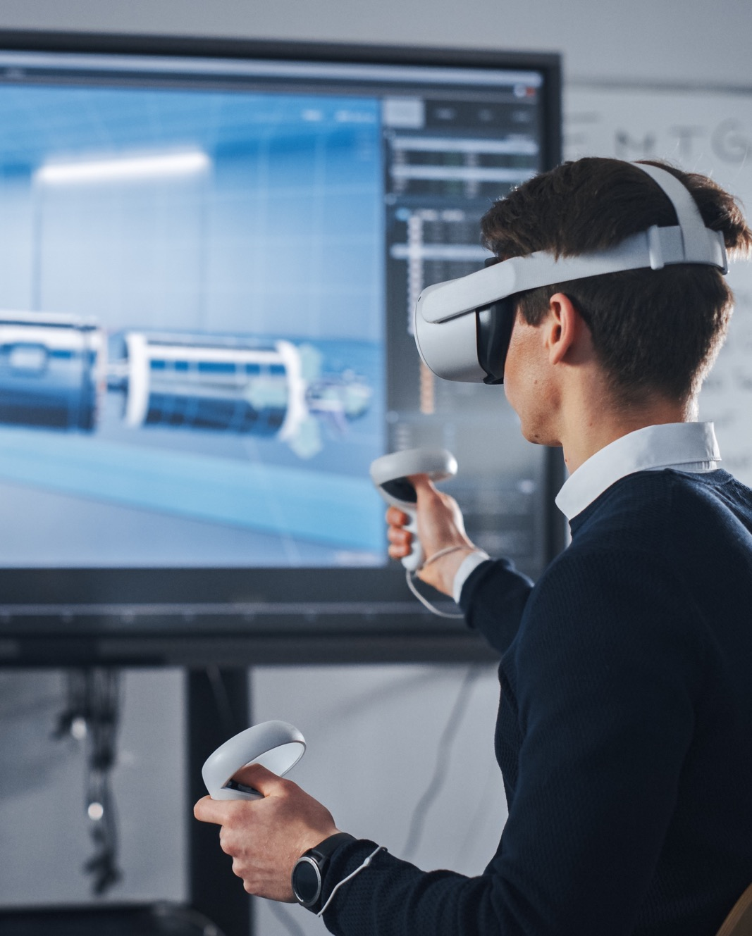
Enhanced Understanding
Students can immerse themselves in systems or concepts from multiple angles as their understanding develops.
Notes:
Immersive experiences can allow for enhanced understanding of systems and abstract concepts. VR/AR/XR allow learners to view systems or concepts from multiple angles as their understanding develops. Learners can view concepts from multiple directions and view reactions in real time.

Slide 16
Exposure
Equity and Inclusion
To accommodate learners with different abilities, information can be presented in alternative ways, and learners can utilize immersive tools for communication and content creation.
Students can experience a variety of careers and real-world simulations—allowing for practice and repetition.
Notes:
VR allows opportunities to experience a variety of careers and engage in real-world simulations, so students can practice their skills and repeat tasks.
• During our research, we visited a health professional school that had developed three immersive simulation rooms. The nursing instructors were able to use these rooms to offer their students a range of simulation experiences, such as emergency room scenarios and home visits. To enhance the experience, the rooms were furnished with relevant items and artifacts.

Slide 17
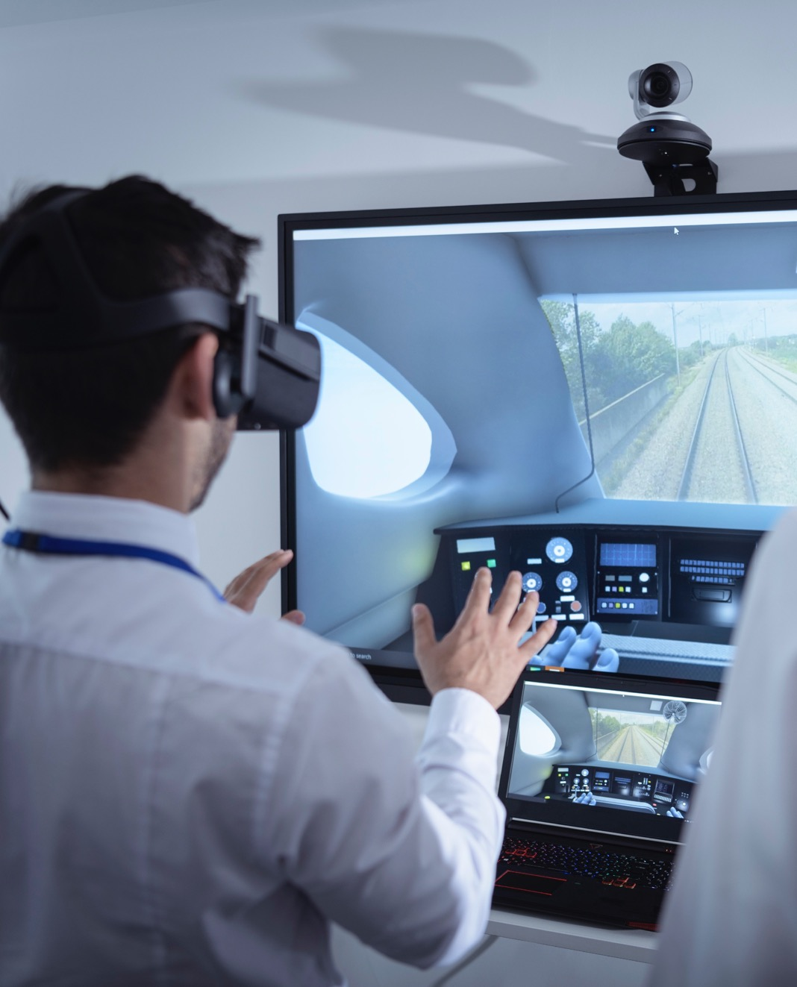
Efficiency and Safety
Learners can participate in a range of different experiences safely.
Health care simulations
Field trips
De-escalation techniques
War zones
Notes:
Immersive technologies offer the possibility of experiencing things that may be impossible or impractical due to various reasons such as distance, time, cost, or safety concerns.
• For instance, students can go on a virtual field trip to Egypt, learn to weld in a safe environment, simulate the experience of inserting a catheter to develop empathy toward patients, or attend virtual meetings with their faculty advisors if they are studying abroad.
• As one education technologist explained, virtual reality technology can be used to simulate risky or costly scenarios. This allows learners to engage in high-stakes, real-world simulations that enable them to practice their skills and repeat tasks.

Slide 18
Design considerations
Notes:
Which leads us to: Design considerations. How do we design effective immersive learning spaces that help students succeed?

Slide 19
Immersive Learning
When designing immersive learning spaces you should consider the following
Safety
Flexibility
Storage and Security
Collaboration
Active risk management when disconnecting from physical surroundings
Adapting the space for multiple learning modes
Balancing security and access for learners and instructors
Learning is social, so it should be in the virtual world
Notes:
When designing immersive learning spaces, you should consider the following:
Safety
Active risk management should be a priority when disconnecting from physical surroundings.
Flexibility
The space should be adaptable to support multiple learning modes.
Storage and Security
There should be a balance between security and accessibility for both learners and instructors.
Collaboration
Learning is a social activity, and virtual learning spaces should facilitate collaboration among learners.

Slide 20
Safety
Motion Sickness
Room to Move
Stable Seating
Make room to respond to action on the headset and offer haptic feedback through fans and high-pile rugs
Leave a 3-foot perimeter around the defined playing field to avoid damaging technology and injuring others
Use solid, stable seating for seated VR/AR/XR experiences
Notes:
Read slide.

Slide 21
Flexibility
Spaces Serve Different Uses
Mobile and Stowable Furniture
Versatility of Space
VR/AR/XR zones and large “cave” displays should be able to serve multiple modes of learning
Using flip-top, nesting tables, and chairs means the room can support a range of learning activities
Technology is changing rapidly, so the space needs to be adaptable to accommodate future innovations
Notes:
Read slide.

Slide 22
Storage and Security
Safe Storage
Provide Power
Mobile Storage
Equipment should be able to be locked away when not in use
Equipment should be charging when not in use to preserve battery life
This can facilitate sharing of assets across classrooms
Notes:
Read slide.

Slide 23
Collaboration
Shared Display
Spectator Zone
Instructor as Facilitator
Provide a shared group display for all learners to view the digital experience
Create a perimeter or outfield viewing area for other learners
Give the instructor a view into the learner experience, to guide and prompt as appropriate
Notes:
Read slide.

Slide 24
Immersive learning space applications

Slide 25
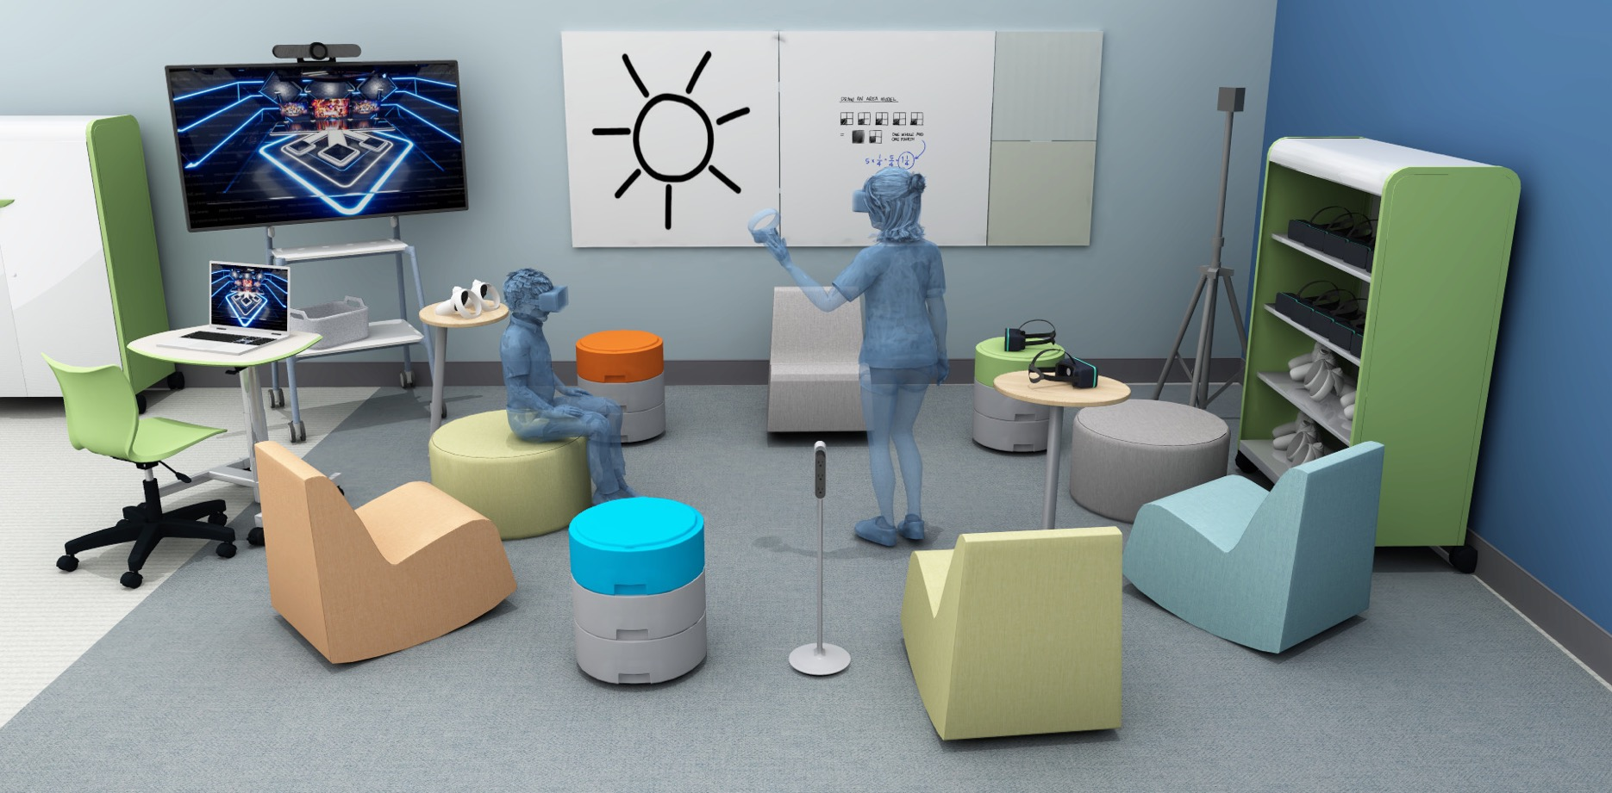
Mobile Shared Cart
3
1
2
Monitor syncs with VR equipment to support social learning and helps educators monitor the experiences
Soft and low-to-the-floor furniture provides a safe environment for immersive learning
Lockable and mobile storage secures technology hardware and allows the sharing of devices across multiple classrooms
Notes:
In a classroom with limited space and technology, the VR cart kit is an affordable option to efficiently share resources among students.
Design Intent: Provide next-generation learning tools for the next generation of kids who have used tech since they were babies.
Equip a small 12’ x 12’ corner of a typical classroom with chairs/stools that wobble or rotate, a storage cart for VR/AR kits, a mobile monitor to see "what they see”, and whiteboards to make learning visible.
Product Names: Flowform Soft Rocker | Flowform 26” Circle Ottoman | Oodle | Thread | Cascade Mega Tower | Orbit Oval Pedestal Table | Groove Adjustable Chair | Silhouette Sit + Stand Student Desk

Slide 26
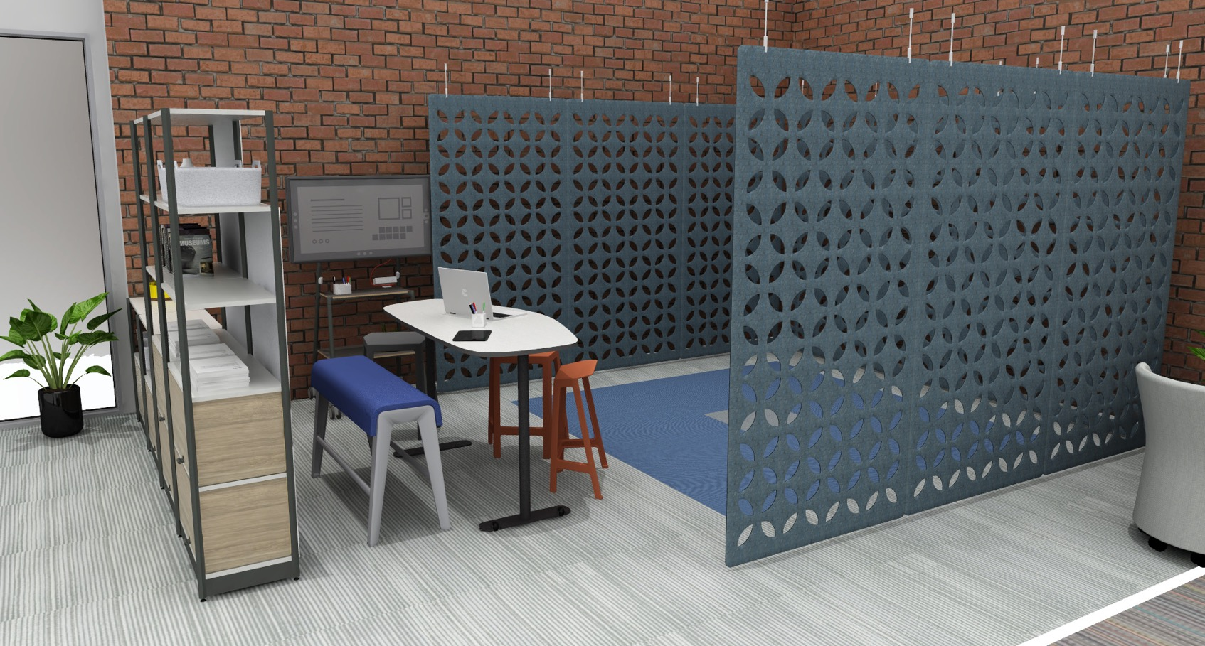
Immersive Corner
3
1
2
Monitor syncs with VR equipment so instructors and peers can participate in the session from a larger space
Play-area floor covering offers contrasting color and texture to give feedback to participants
Visual barrier provides some privacy for participants and a soft touchpoint between the walls
Notes:
Design Intent: Utilize dead spots on campus with a VR/AR setup to encourage learning in a different physical environment. Provide tools for augmented project-based learning and collaborative interactions what is experienced in the virtual world.
Product Names: Flex Active Frame | Flex Media Cart | Flex Perch | B-Free Beam | Elbrook Team Table | AMQ 3F Hanging Panels

Slide 27
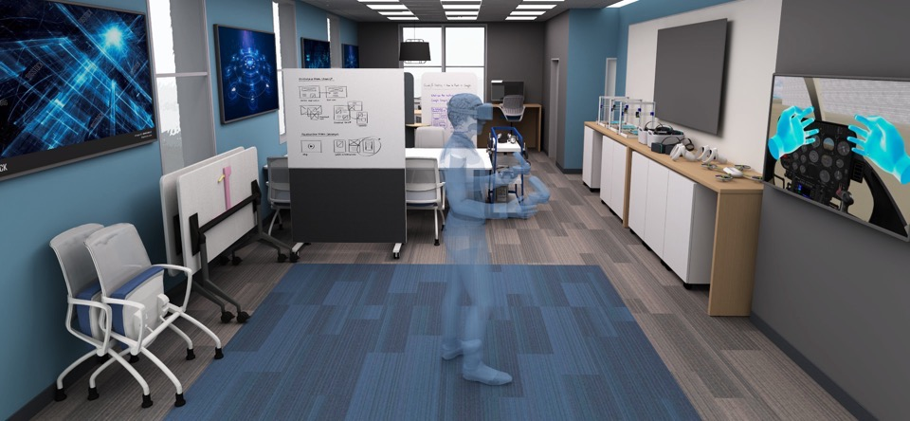
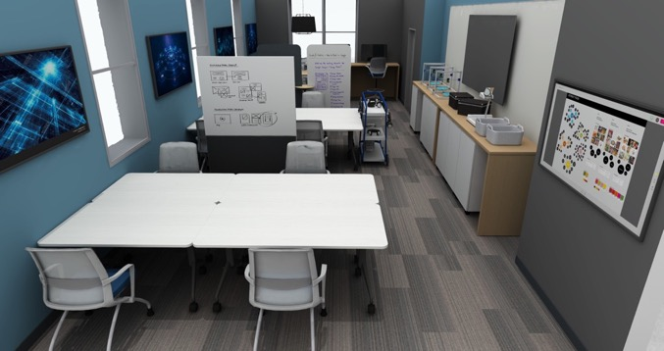
Tech Exploration Hub
2
3
1
4
Play area floor covering offers contrasting color and texture to give feedback to participants
Visual barrier provides privacy
Monitor syncs with VR equipment so instructors and peers can participate in session
Multipurpose room converts into a virtual exploration area by flipping and nesting furniture out of the way of the user experience
Notes:
Design Intent: Leverage the flexibility of multipurpose furniture to switch from a meeting area or workspace to an immersive testing space. Clear furniture out of the way to explore, play, learn, and interact with different emerging technologies.
Product Names: Bixby Chair | Groupwork Flip-Top Rectangle Table | Campfire Big Table Half Depth | Campfire Mobile Storage Cabinet

Slide 28
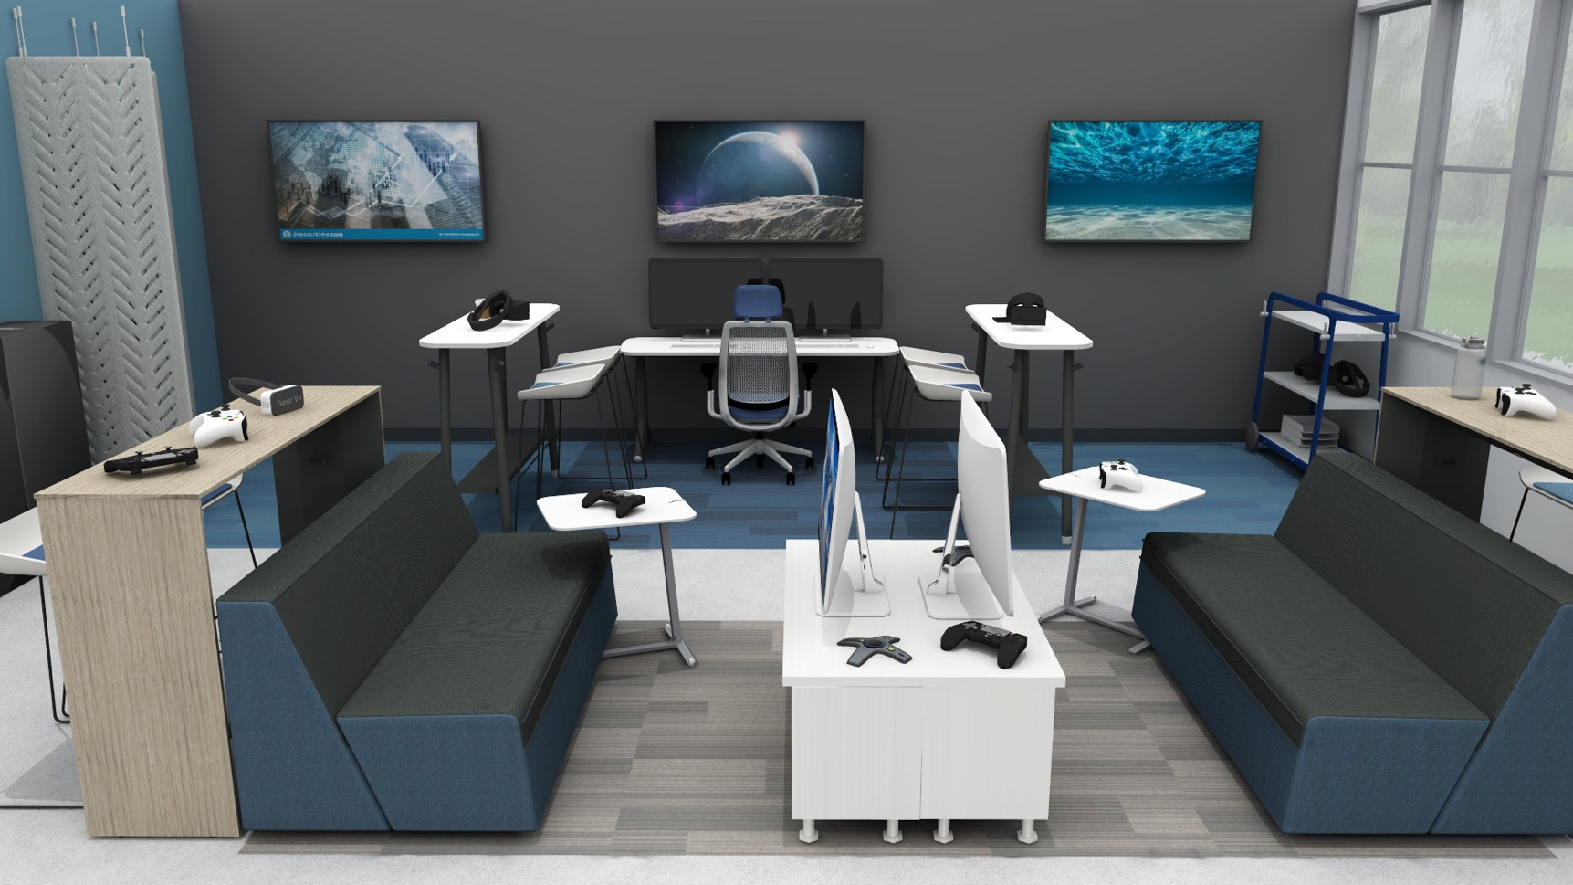
Gaming Lounge
1
2
3
Simple playing bays allow multiple sessions to take place at the same time
Dividers define each space; curtains can be open or closed depending on desired function
Adjacent console gaming space encourages community
Notes:
Design Intent: Casual gaming lounges in schools organically teach fortitude, endurance, comradery, and teamwork among numerous other skills. Gaming is proving to be a gateway to careers in software and game development, finance, cybersecurity, etc.
Product Names: Campfire Lounge | Campfire Standing Height Slim Table | Scoop Stool | Series 2 Task Chair | Flex Slim Table | Flex Cart | AMQ 3F Hanging Panels | Campfire Skate Table | Currency Low Storage

Slide 29
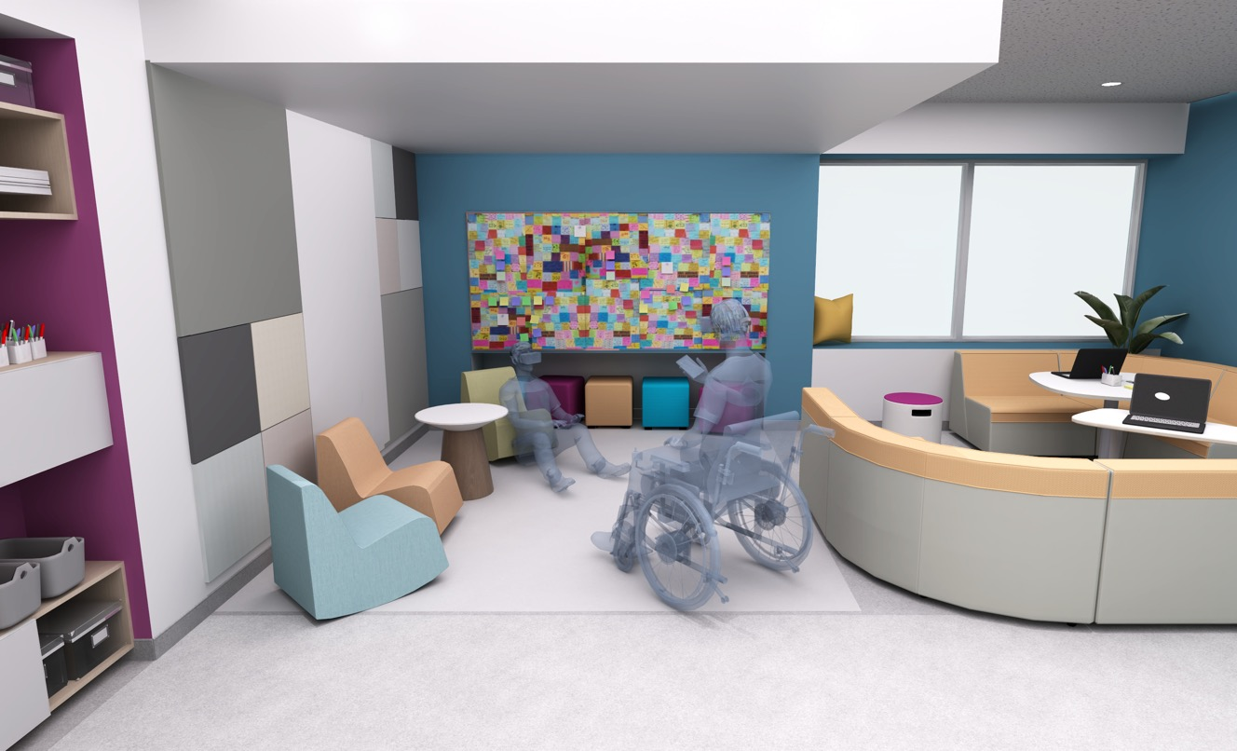
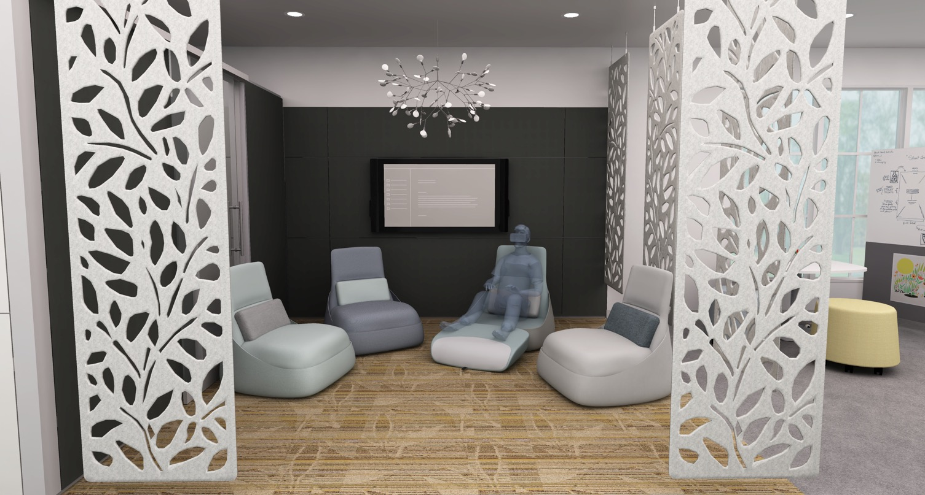
Sensory Space
1
2
2
Analog interactive tools include whiteboard and paper table
Soft and low-to-the-floor furniture provides a safe environment for immersive learning
Notes:
Design Intent: Learning is experiential so offer all students the opportunity to feel welcome and safe exploring the world from their physical location through a variety of realities. Create settings with soft touchpoints, flexible comfort, and accesible tools to encourage immersive learning with a sense of well-being.
Product Names:
A – Flowform Soft Rocker | Campfire Paper Table | B-Free Small Cube | Campfire Lounge | Motif
B – AMQ 3F Hanging Panels | Hosu Lounge Chair

Slide 30
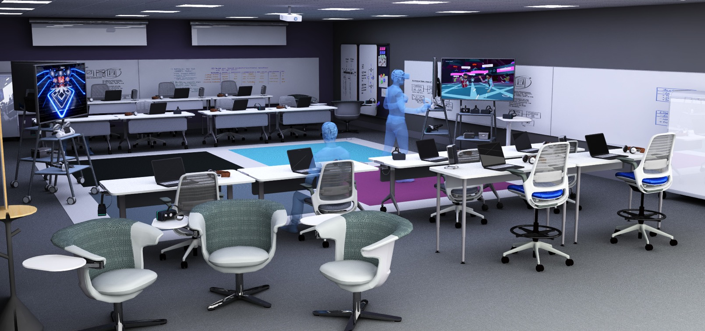
XR Computer Lab
2
3
1
Stable, rotating seating supports the posture and movement of immersive experiences
Monitor syncs with VR equipment to support social learning
Flexible furniture with tiered seating supports active learning as students create their own immersive experiences
Notes:
Design Intent: Developing immersive software involves a process of thinking, prototyping, and testing ideas before they become a reality. Provide development teams workspaces to try out and discuss the output in real time before the next iteration.
Product Names: i2i Collaborative Chair | Series 1 Chair and Stool | Verb Rectangle Table Standing Height | Verb Rectangle Flip-Top Table | Flex Media Cart

Slide 31
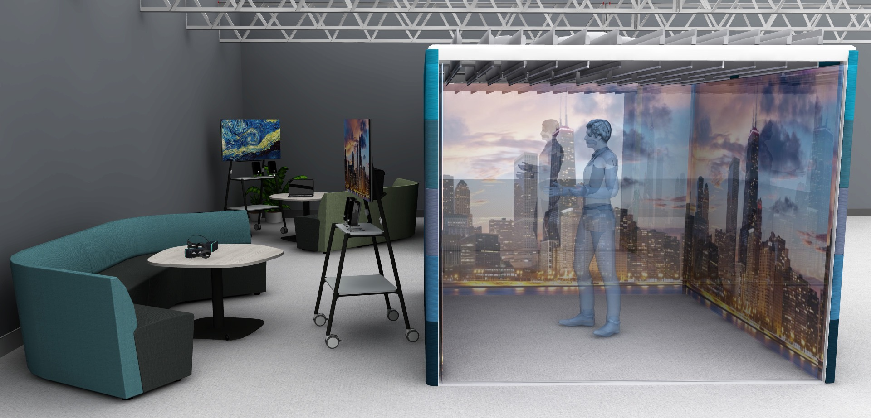
Small Immersion Pod
1
2
Projection on walls supports immersive experiences without requiring individual headsets
Self-contained pod can be relocated and repurposed as needed
Notes:
Design Intent: Projectors cast immersive images on the walls of a small immersion pod without the need for a headset. Team members outside the pod can see, hear, and talk to the person in the experience as though they were also “there.”
Product Names: Campfire Lounge | Flex Media Cart | Elbrook Huddle Table | Orangebox Air3 Pod

Slide 32
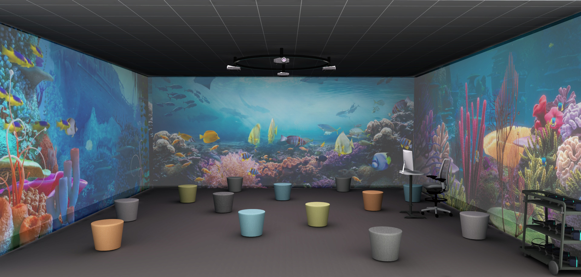
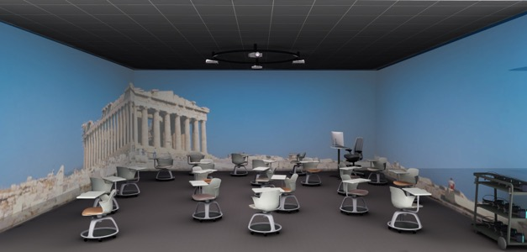
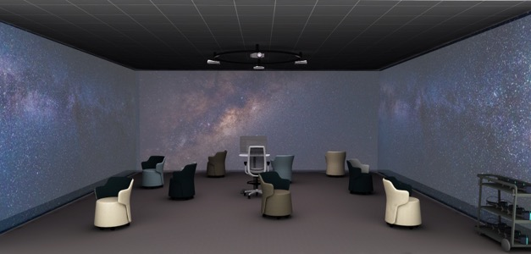
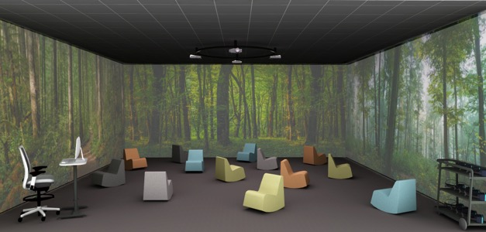
Large Multipurpose Immersion Cave
1
2
Projection on walls supports immersive experiences without requiring individual headsets
Soft, backless stools provide seating without obstructing sightlines
Notes:
Design Intent: The large immersive hub is truly a group learning activity where many students can be in the space surrounded by 360-degree images all the way around them. The feeling of immersion is intense and more complete in a physical, cognitive, and emotional way.
Product Names: Flowform Cylinder Stool | Node Tripod Base With Worksurface | Skomer Armchair | Flowform Soft Rocker

Slide 33
Better is possible.
Let us show you how.
Notes:
Better is possible. Let us show you how.

Slide 34
We’re Here to Help
01
Learn
Research and insights
Next Steps
02
Be Inspired
Sign up for a virtual tour featuring emerging learning spaces, including immersive learning experiences
Explore new applications for your learning and work spaces
Engage in a workshop to discover new needs
See and experience spaces
03
Discover
Workshops and consulting engagements
04
Create
Solutions for your organization
Notes:
All of our resources are dedicated to providing you with the right next step, whether it’s to learn, be inspired, discover, or create your hybrid learning experience. ​
NOTE: This slide can be customized (in the right-hand column) based on your client’s interests and needs. ​​

Slide 35


